Slide 1
Macro-Economic Environment of United States.
Group 2
Jaswanth Guttikonda, Jong-Kai Lee
Shivani Dilip Jagtap, Sahil Jaswal,
Sushma Vijayeendra Karjol

Slide 2
Outline
Introduction
Analysis
Conclusion
References

Slide 3


Introduction
Datasource used
Worldometers
WHO
Kaggle-website

Slide 4
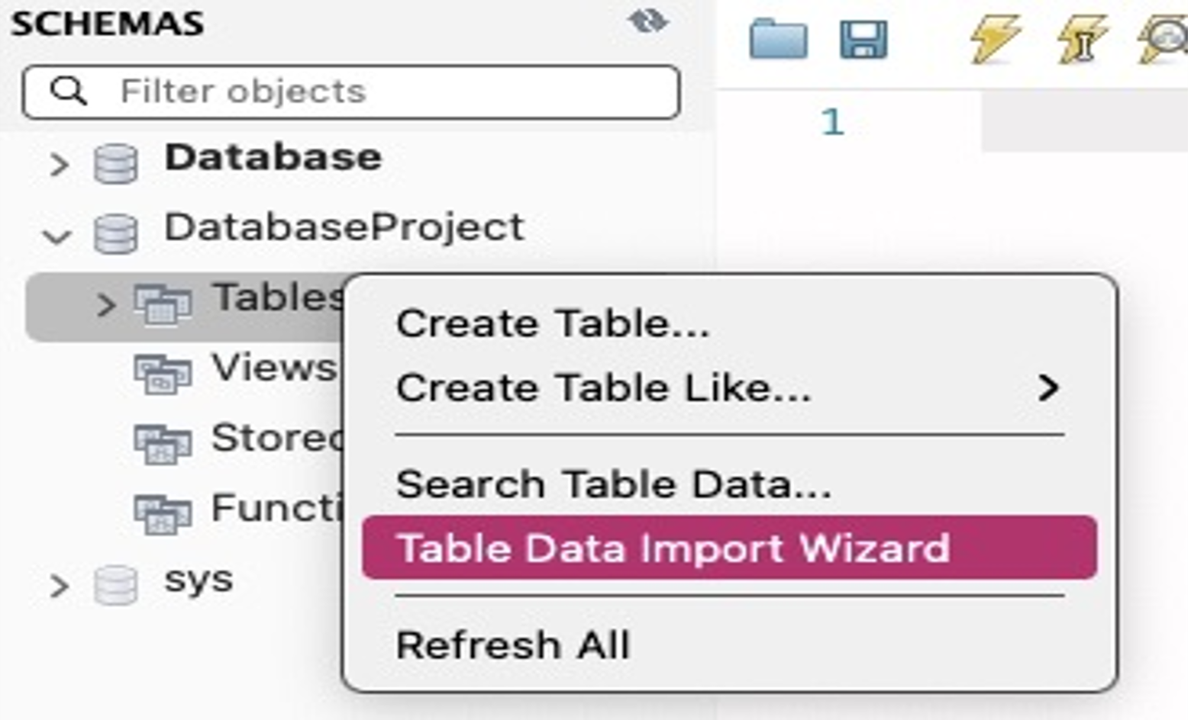
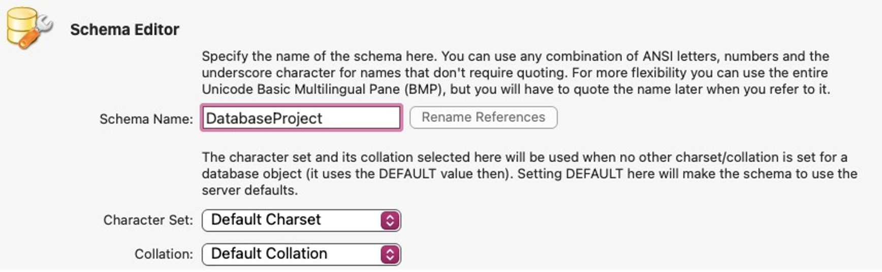
Analysis-Creating a database
2. Import data
1. Create Schema

Slide 5
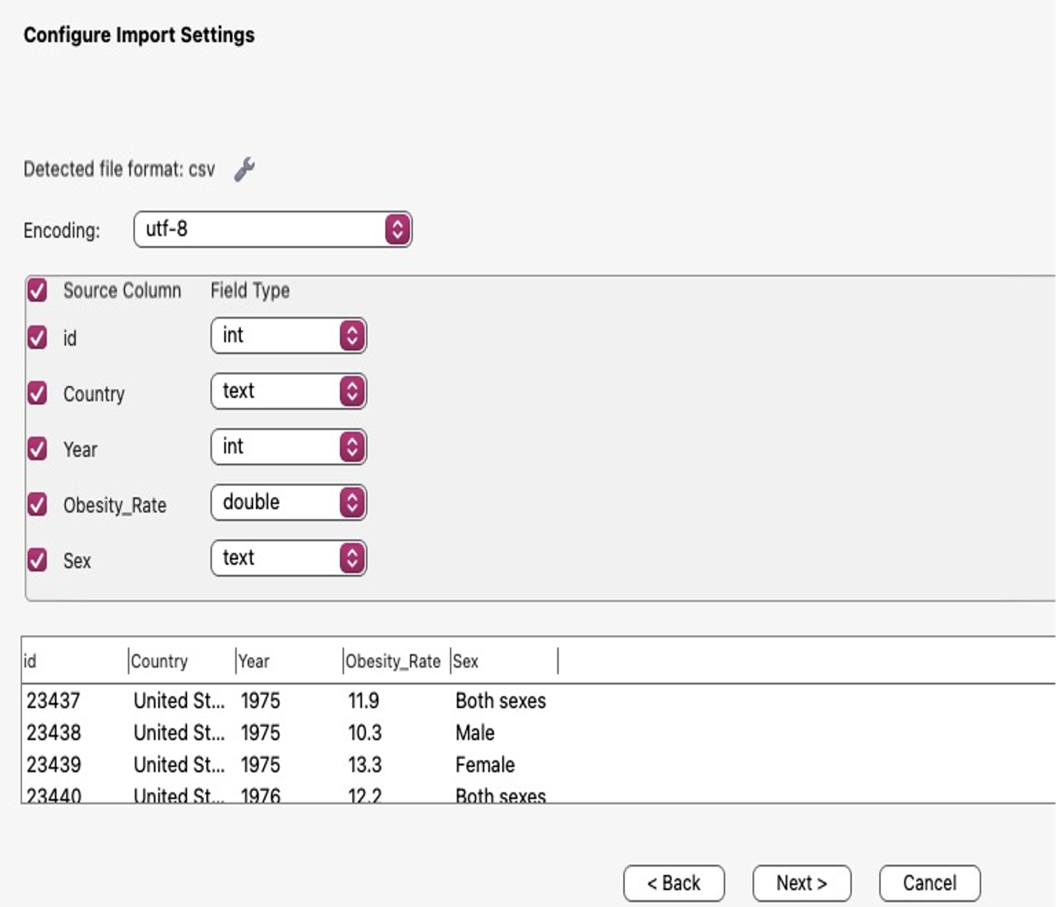
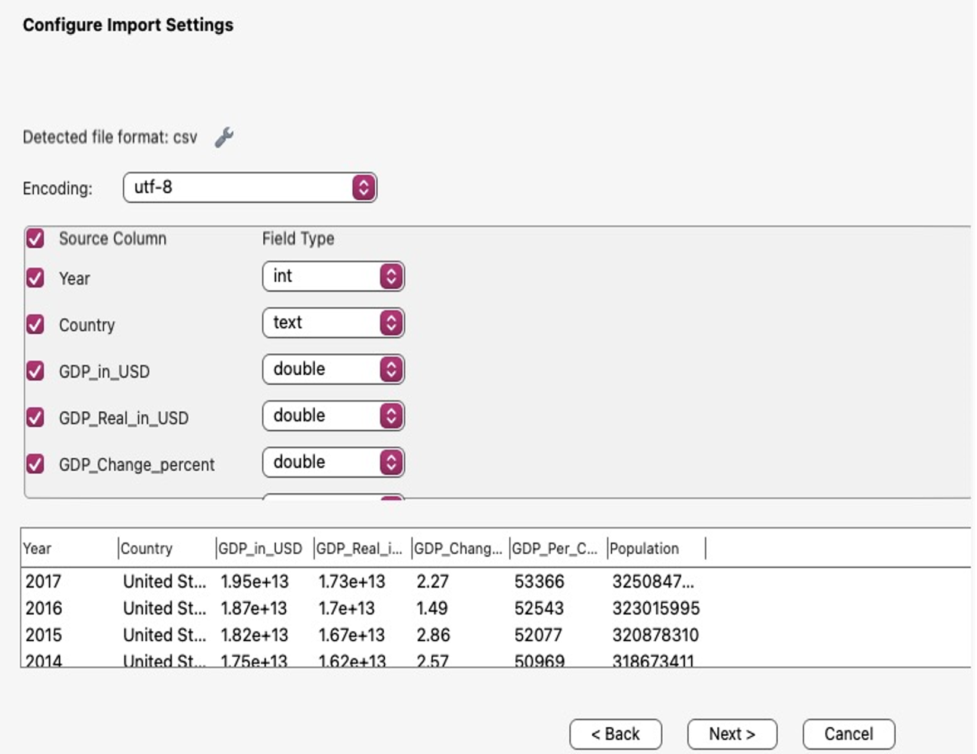
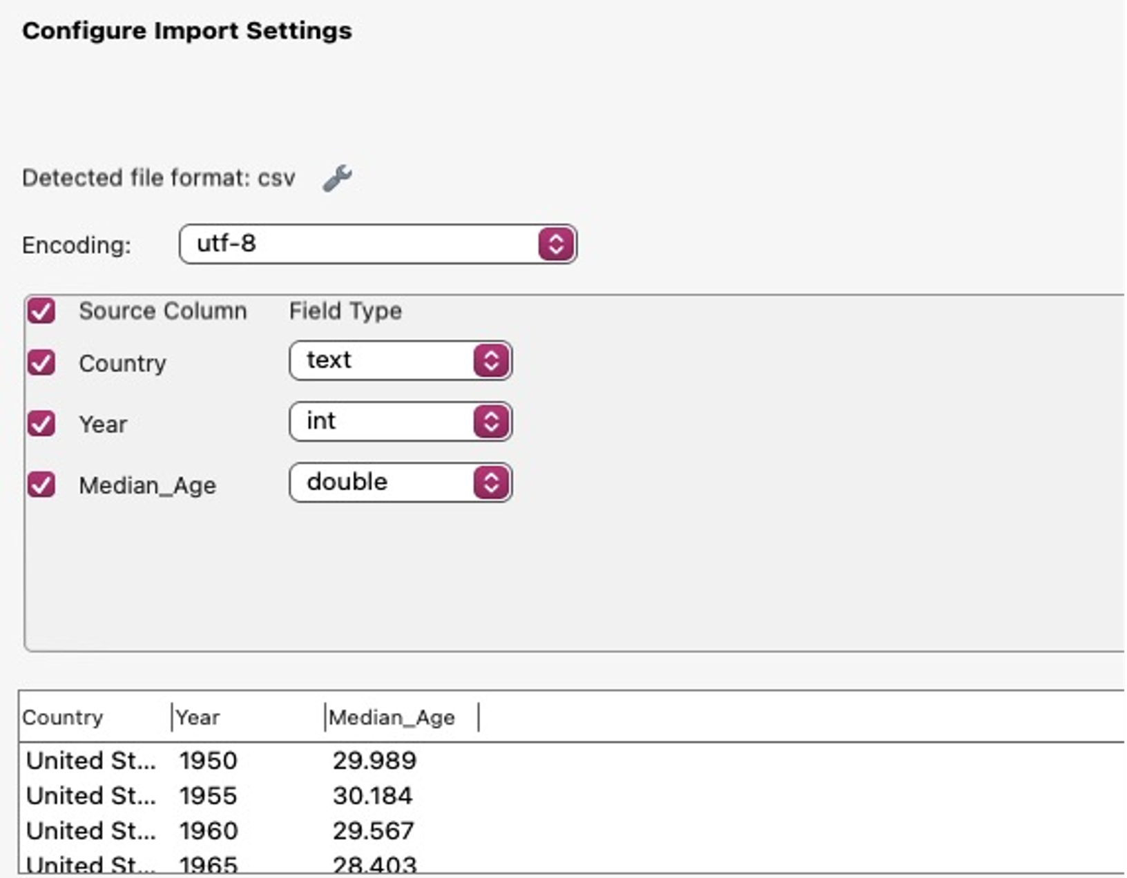
Analysis-Defining Variables for all the Three Tables

Slide 6

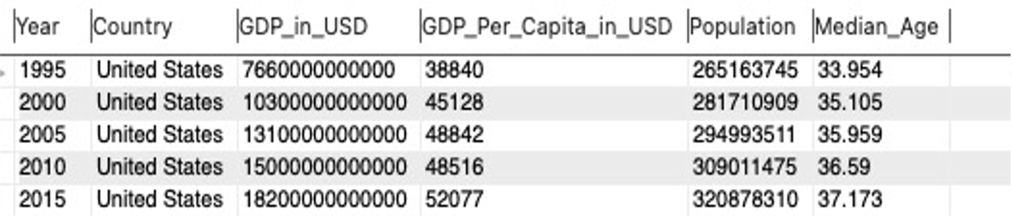
Analysis-Joining Two Tables, GDP and Median age

Slide 7
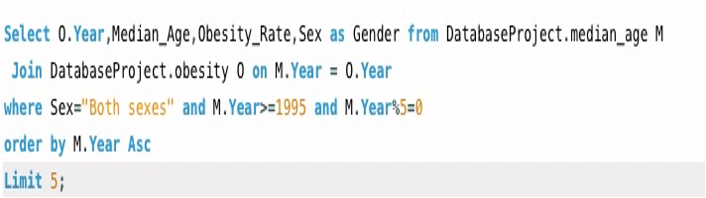
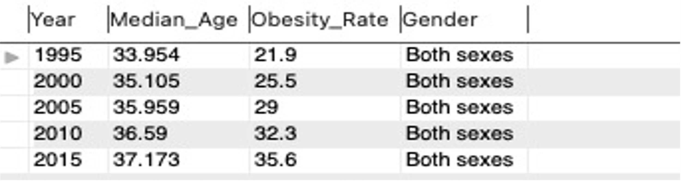
Analysis-Joining Two Tables, Median age and Obesity

Slide 8
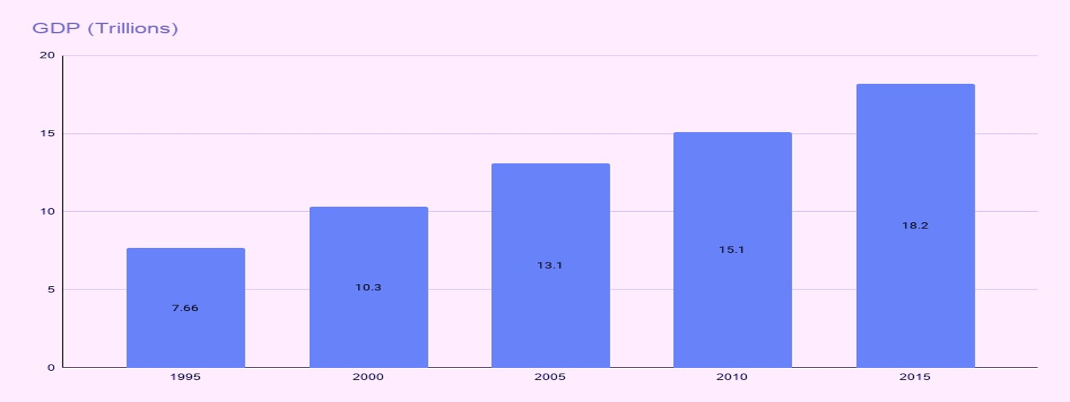
Conclusion-considering median-age, GDP, and population
There is a positive co-relation between the median-age, GDP and population in US for last twenty years between the year 1995-2015. The rate at which the population is increasing, median age of the US people is also increases at the positive rate.

Slide 9

Conclusion-considering median-age, GDP and population
How this conclusion was determined.

Slide 10
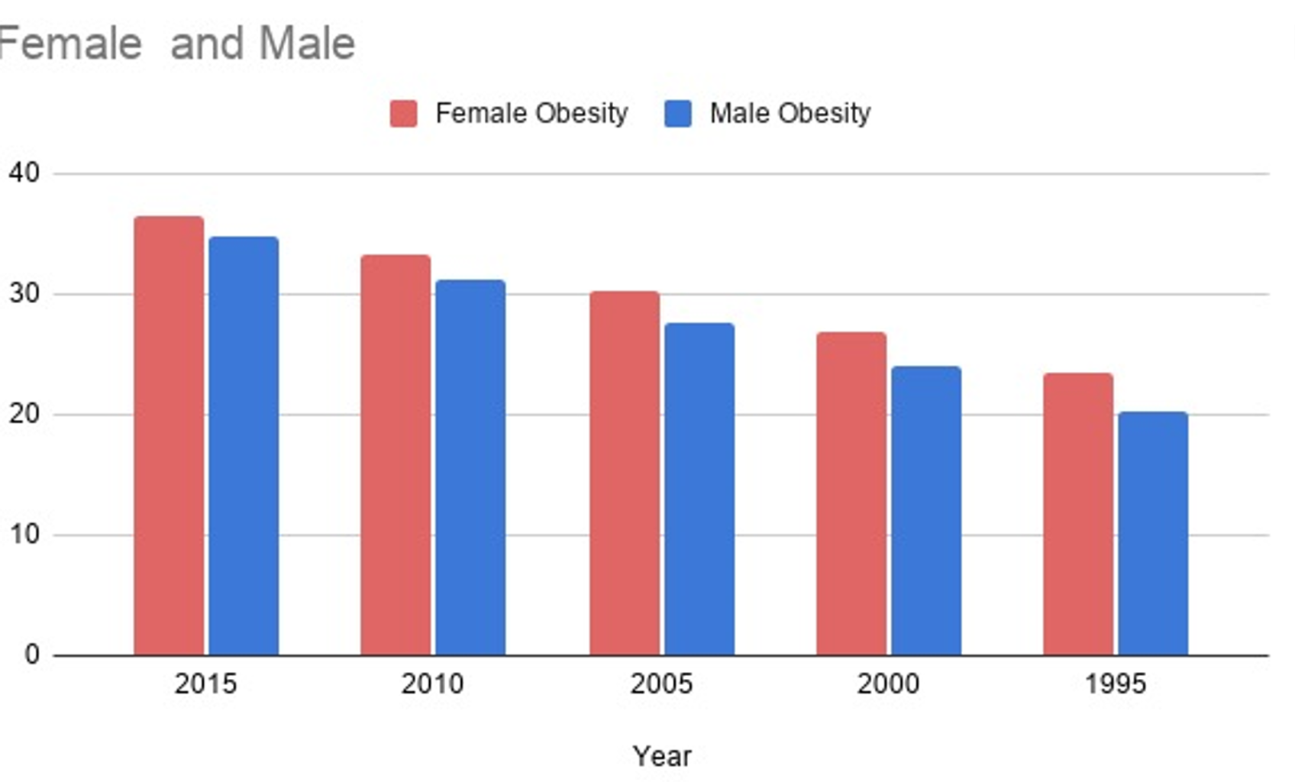
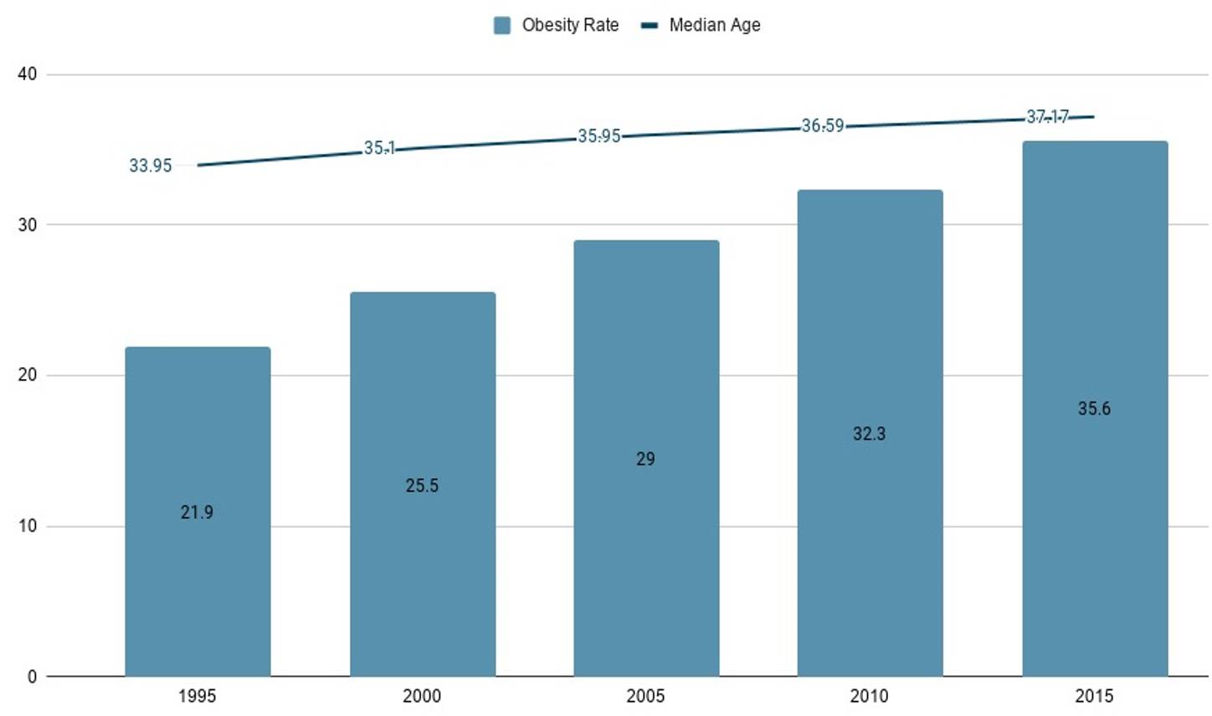
Conclusion-considering median-age, obesity rates and its gender
Obesity rates of both the genders have been increasing steadily at an equivalent rate. In comparison, the median age has also been increasing as the population is growing.

Slide 11
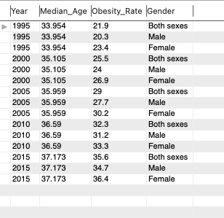
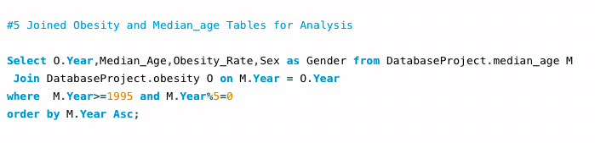
Conclusion-considering median-age, obesity rates and its gender
How this conclusion was determined.

Slide 12
References
Gross domestic product. (n.d.). Worldometers. Retrieved February 19, 2021, from https://www.worldometers.info/gdp/
Prevalence of obesity among adults, BMI ≥ 30, age-standardized Estimates by country. (2017, September 22). WHO. https://apps.who.int/gho/data/node.main.A900A?lang=en
Average age of countries. (n.d.). Kaggle. Retrieved February 19, 2021, from https://www.kaggle.com/divyansh22/average-age-of-countries

